Slide 1

Airbnb Price Prediction
Prof. Sergiy Shevchenko
GROUP 3 PRESENTATION
Durga Bhanu Nayak
Akash Raj
Harshit Gaur
Jeseeka Shah
Abhigna Ramamurthy

Slide 2
Agenda
Introduction
Business Questions
Exploratory Data Analysis
Predictive Modeling
Model Comparison
About the Dataset
Data Visualization
Conclusion

Slide 3
Introduction
Airbnb Business Case Study using ML models.
Dataset extracted from Airbnb of major US cities
The objective is to predict listing price based on user inputs over the Streamlit UI
ML predictive methods like Linear Regression, Decision Tree, Random Forest, and XGBoost algorithms are used
Using LIME and SHAP for model interpretability
Audience include Customers, Hosts and Airbnb

Slide 4
Business Question
Identify factors contributing to Airbnb listing prices
Help customers and hosts get a sense of Airbnb listing prices based on important features
Organizational benefits include optimizing predictive models to improve service and search

Slide 5
About the Dataset
Airbnb Data Source: http://insideairbnb.com/
Data Size: 210,617 listings in US with 23 features
Only 23 out of 74 features picked to avoid redundancy
Removed records with missing values as part of data cleaning
Data Pre-processing included
Amenities, host_response_time categorical variables to integer
True/False categorical variables(host_has_profile_pic, host_identity_verified, instant_bookable) to Boolean values
Percentage of host_response_rate to floating value
Dummy variables for room_type
Outliers falling outside of inner and outer bounds are deleted

Slide 6
Exploratory Data Analysis
Majority of people in US prefer renting either entire apartment or a hotel room with average rental prices higher than other accommodation types
Low average price for shared room can be observed for being one of the least preferred stay options
Extreme prices can also be observed based on the venue or amenities across all the accommodation types

Slide 7
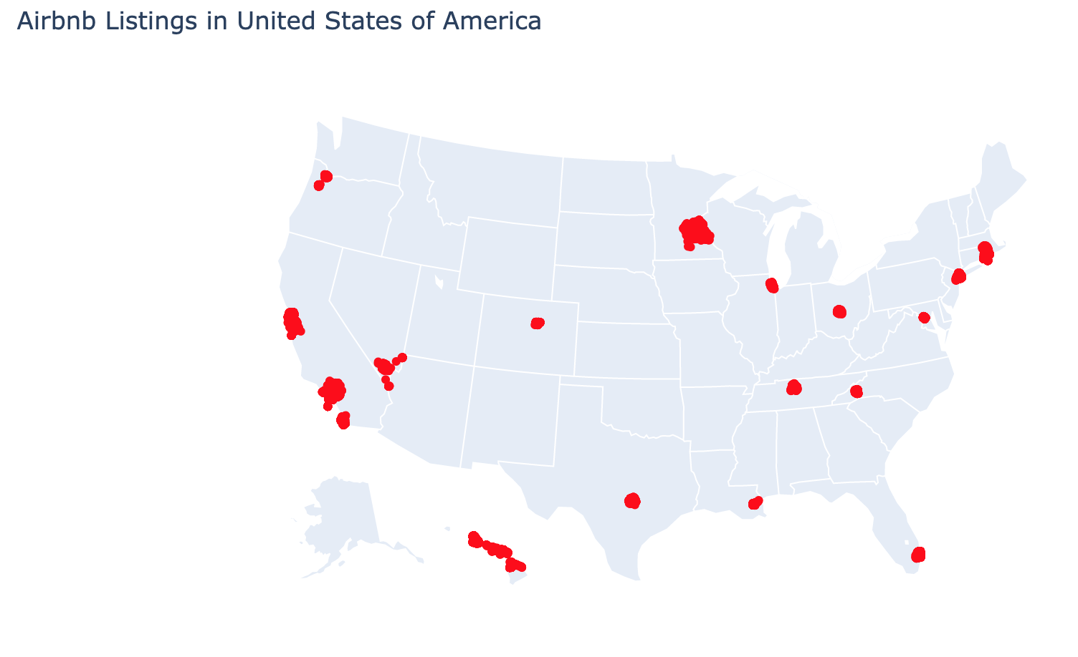
Data Visualization
Majority of the listings are concentrated in major cities in the US

Slide 8
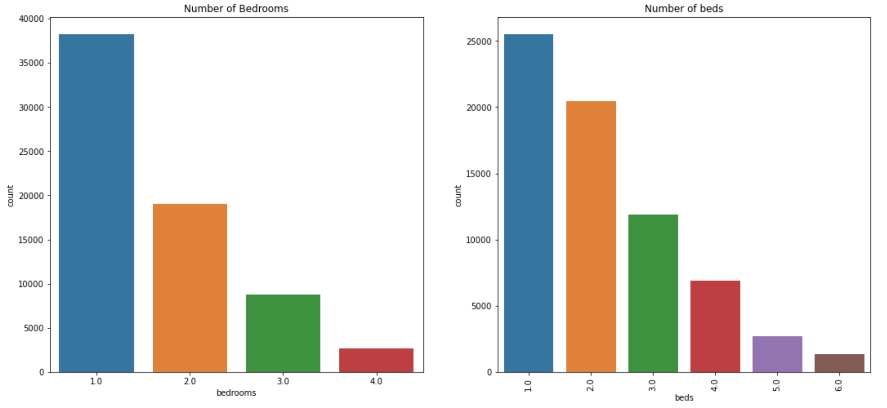
Data Visualization
Majority of the listings have one bedroom with 1 or 2 beds.

Slide 9
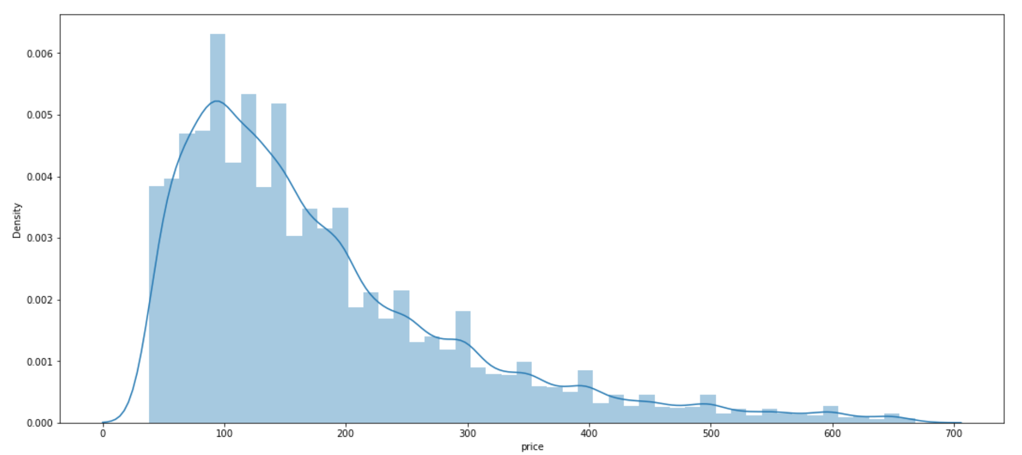
Data Visualization
Majority of the listings have peaked at $100 price

Slide 10
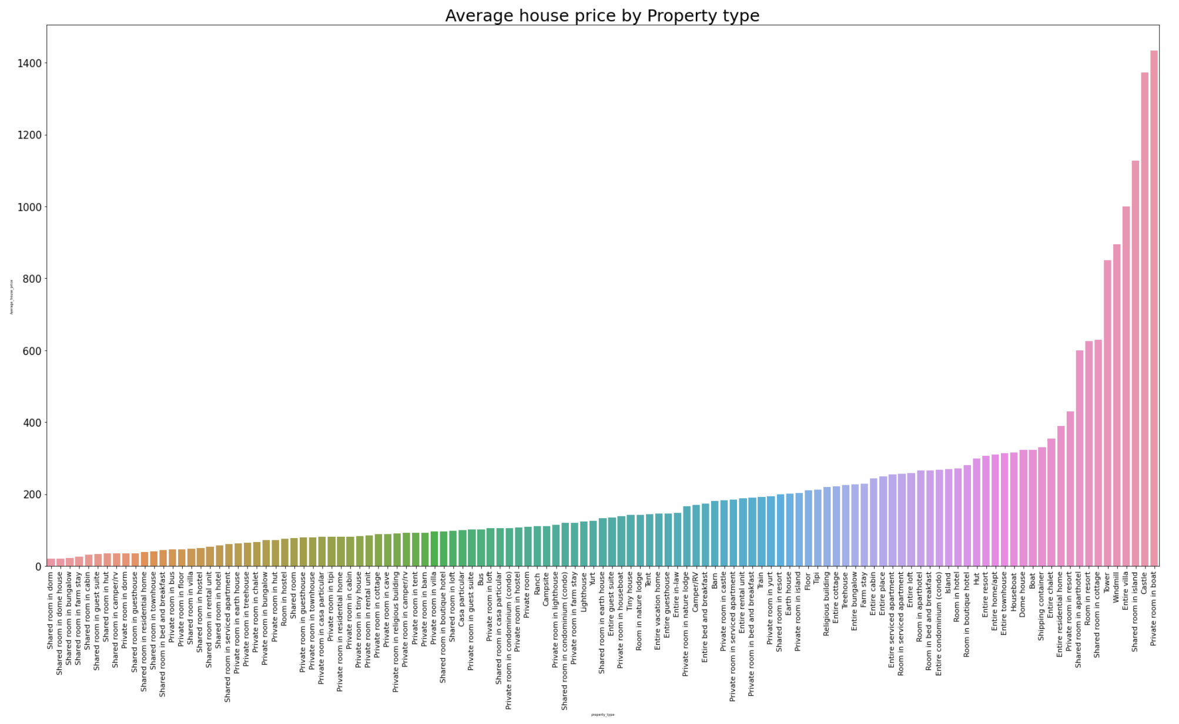
Data Visualization
Shared room in dorm costs the least price on an average and Private room in boat costs the highest

Slide 11
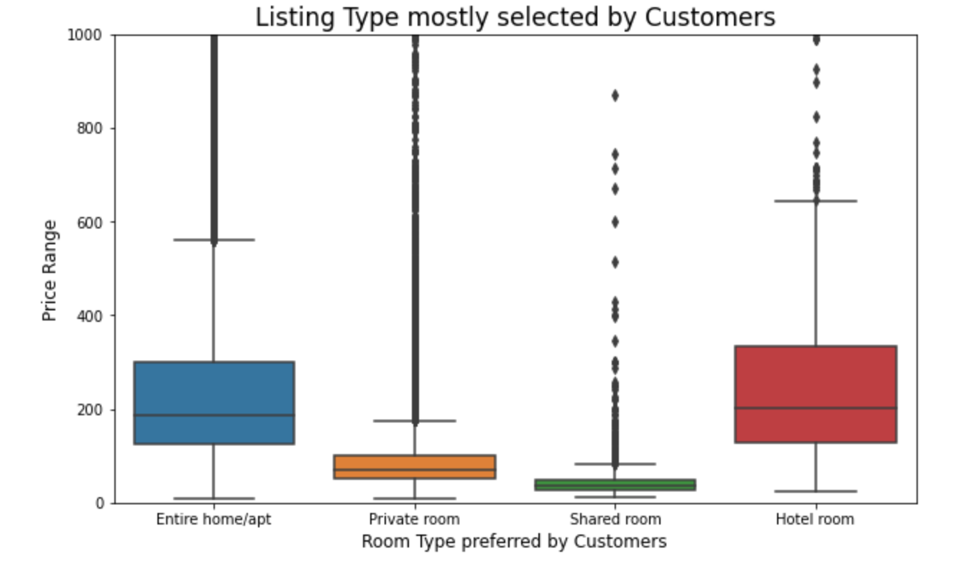
Data Visualization
Majority of the people prefer hotel room or an entire home/apt

Slide 12
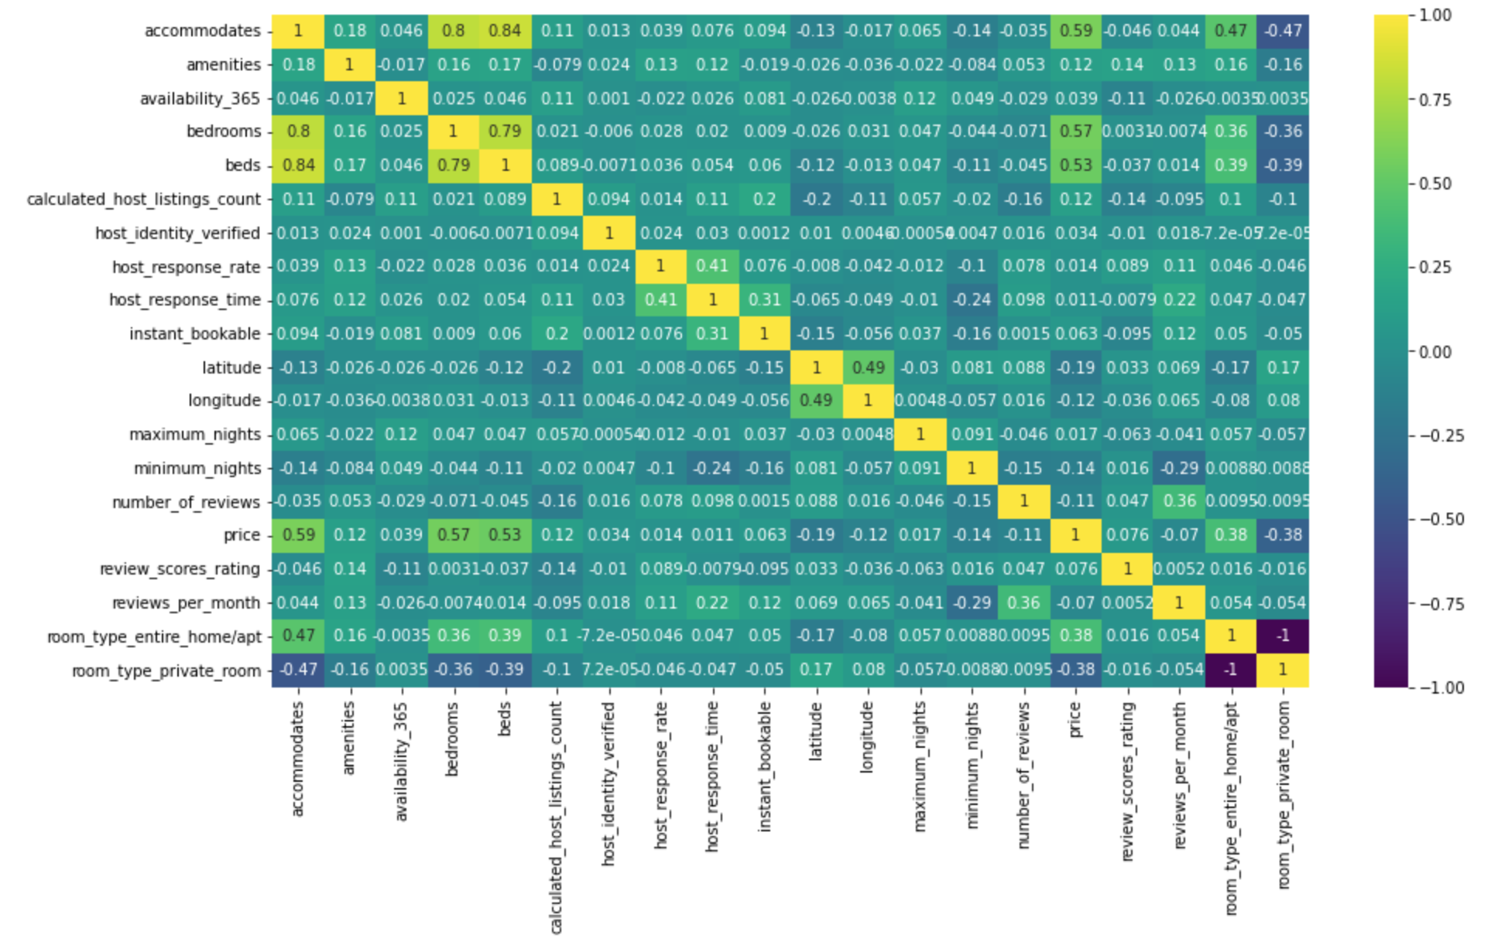
Correlation Matrix
Price has the highest positive correlation with accommodates, bedrooms, and beds in the respective order
Increase in the above-mentioned variables increases the price of the property listing

Slide 13
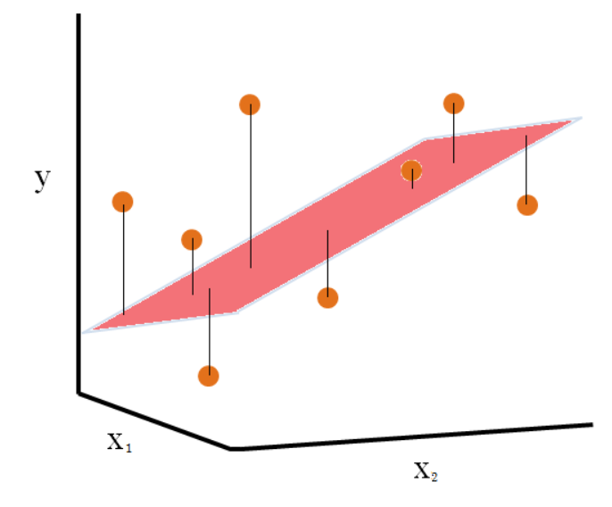

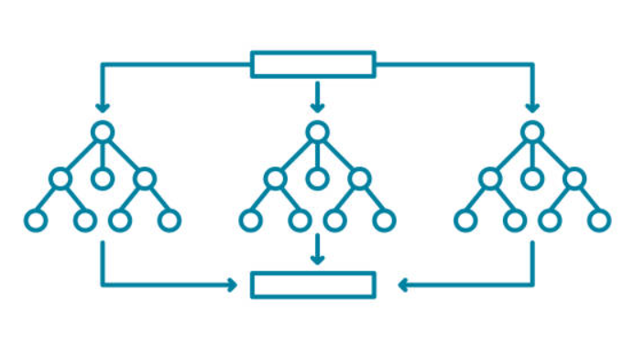

Predictive Modeling
Train and Test data split from cleaned data with ratio 7:3 resp.
Label Encoded the categorical variables
Scaled the numeric variables using Robust Scaler to level up the variations
ML model used to predict the price:
Linear Regression
Decision Tree Regression
Random Forest Regression
XGBoost
LIME and SHAP are used to interpret the model’s predictions at the local and global levels.
Linear Regression
Decision Tree
Random Forest

Slide 14
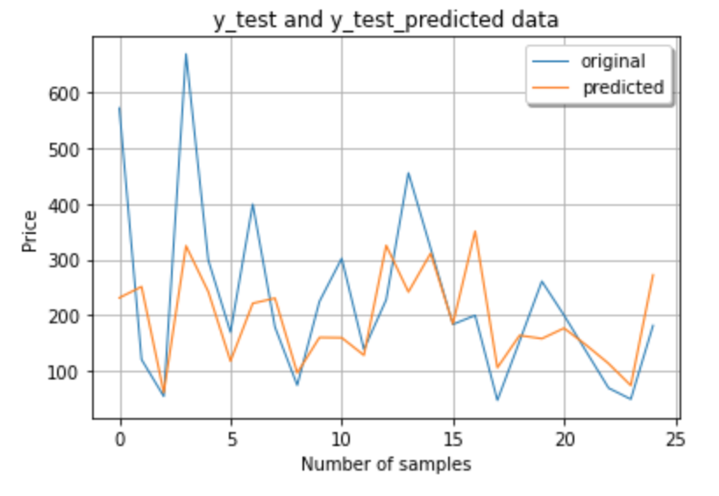
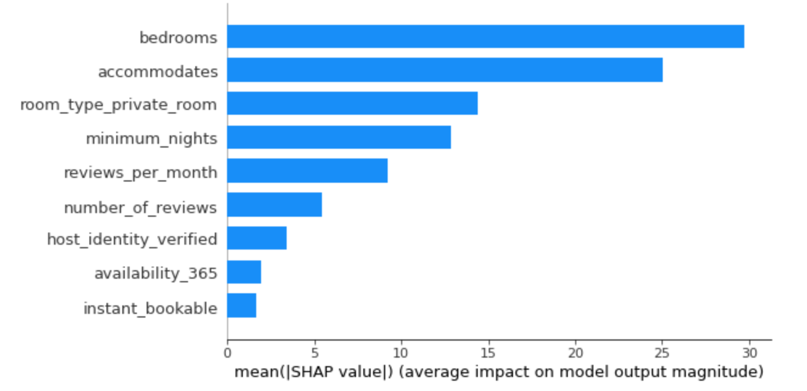
Linear Regression
Used the default hyperparameter for the linear regression model
R^2 value is 0.42 which is low
It can show us that the model doesn’t suffer from overfitting with an accuracy of 57.48%
Bedrooms and accommodates showcase the highest feature importance through linear regression

Slide 15
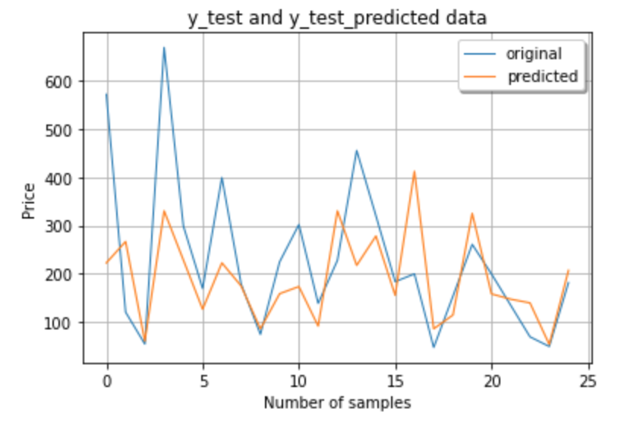
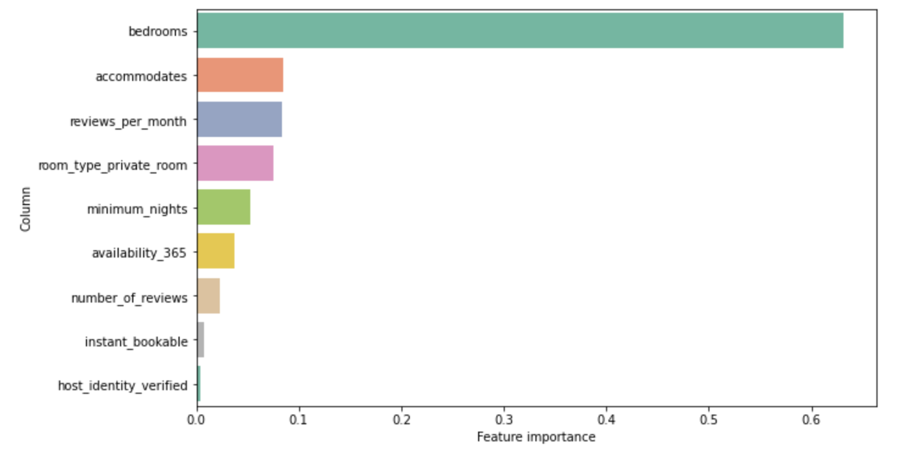
Decision Tree
Experimented with several hyperparameters and arrived at below combination for best results
Criterion as friedman_mse
max_depth as 10
R^2 value is 0.5 on training data and 0.4 on test set which shows to avoid overfitting with an accuracy of 58.75%
Bedrooms and accommodates are given the highest feature importance similar to linear regression

Slide 16
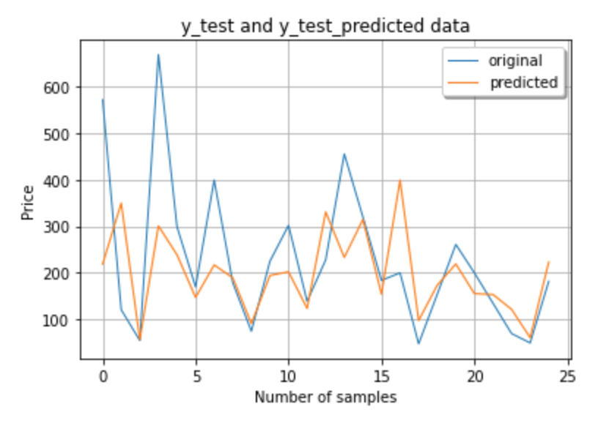
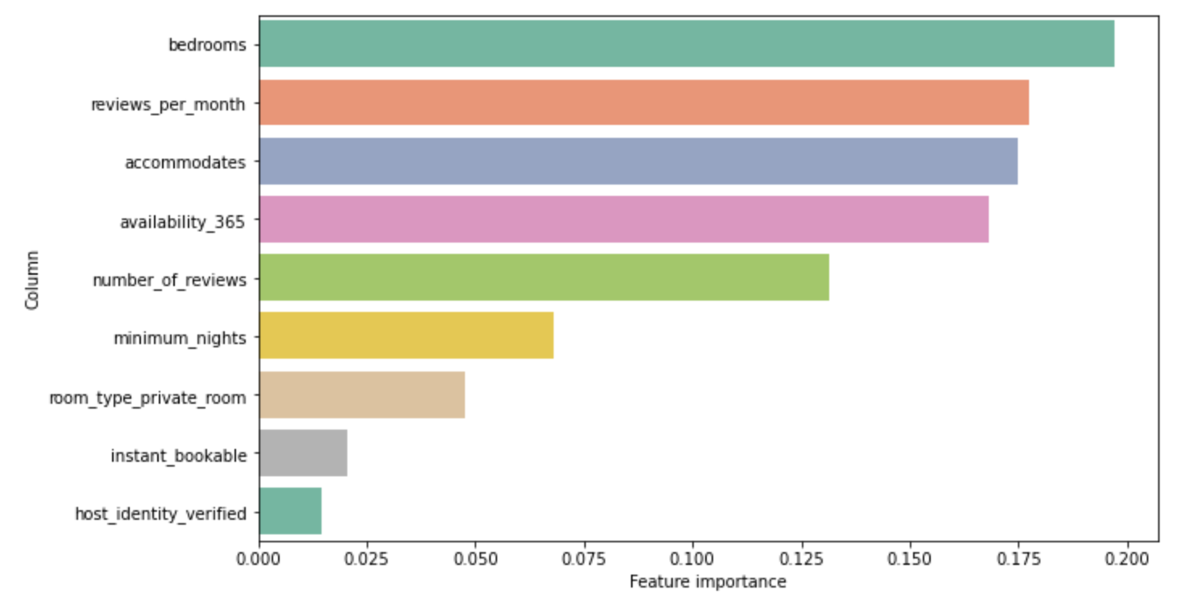
Random Forest
Experimented with several hyperparameters and arrived at below combination for best results
n_estimators as 100
Achieved R^2 value of 0.92 for training set and 0.42 on testing set with a model accuracy of 58%
Top 3 important features include bedrooms, reviews per month and accommodates

Slide 17
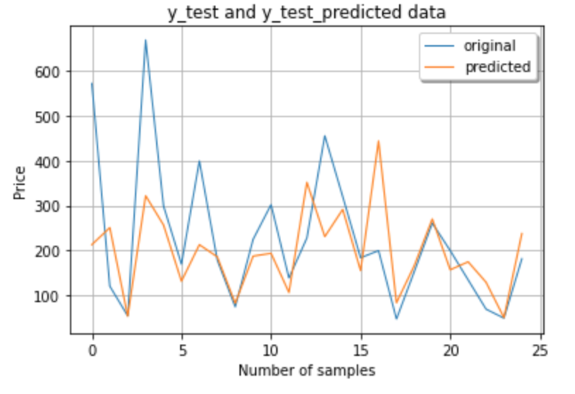
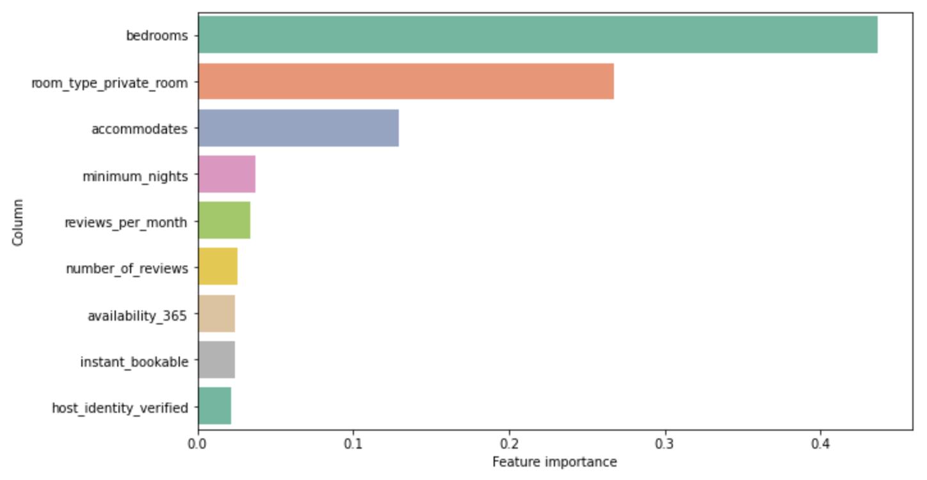
XGBoost (Extreme Gradient Boosting)
Experimented with several hyperparameters and arrived at below combination for best results
n_estimators as 100
Achieved R^2 of 0.7 on training set and 0.44 on testing set with an accuracy of 59.97% which is the highest among all four models
Feature importance shows bedrooms, room type private room and accommodates to be in majority

Slide 18
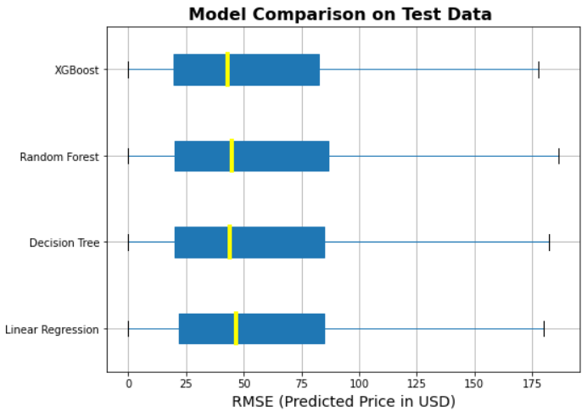
Model Comparison
Appointed Root Mean Squared Error (RMSE) to compare the performance of the models
XGBoost is found out as the best model to perform among all the models given the least RMSE value
Decision Tree is also performing nearly similar to XGBoost

Slide 19
Streamlit UI Application Demo
https://eaiproject.herokuapp.com/

Slide 20
Conclusion
In this project, we use the Airbnb dataset with 210,617 listings and 23 features to explore
We go through different data science steps to preprocess the data, such as Data Collection, Data Cleaning, Data Manipulation, Data Visualization, and Data Reduction
We built 4 models to predict the price of listings. They are Linear Regression, Decision Tree, Random Forest and XGBoost. The XGBoost and Random Forest models give the highest R^2 score on the test set (0.44 vs. 0.42)
We use LIME, SHAP and Feature Importance to find out how features affect the price at the local and global levels. We have a conclusion that 3 features bedrooms, accommodates, room type affect the price most

Slide 21

Thank you

